Slide 1

Credit Card Defaulter Prediction
Sudhanshu Rastogi

Slide 2
Objective:
Credit Card payment default occurs when you fail to pay the Minimum Amount Due (MAD) on the credit card for a few consecutive months. Usually, the default notice is sent by the card issuer after 6 consecutive missed payments.
Consequences of Credit card payment default
Lawful Punishments Suspended Credit Card Account Detrimental Effect on Credit Score
High-Interest Rates Asset Possession
In this project we classify customers as potential defaulter given personal and 6 months banking details.
The main goal of this project is to develop a Credit Card Defaulter Prediction model and deploying the model using streamlit as an Web App.
Benefits:
The Credit Card Defaulter prediction App will give defaulting probability instantly and has the potential to help companies reduce losses by not issuing credit card to risky.

Slide 3
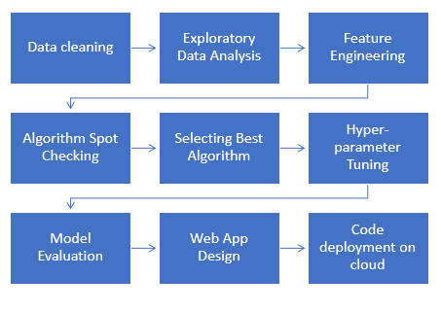
Architecture
Data Preparation
Model development
Deployment

Slide 4
Data validation and transformation
dAta type | Null values | Numerical columns | Categorical columns
Data type of columns is given in the schema file. It is validated when we insert the files into Database. | If any of the columns in a file have all the values as NULL or missing, we can fill it by median or mode methods. | All the numerical features were standardized using Standard Scaler, preventing any data leakage. | One Hot Encoding was used to treat categorical columns for the model in understandable way.
If data type is wrong, we can convert it using pandas library. | We can fill them by using mode of categorical columns or mean of numerical columns. | This process is done in pipeline for numerical features for the convenience of deployment. | This process is done in pipeline for categorical features for the convenience of deployment.

Slide 5
Model Training
The data in database is imported to Jupyter notebook by using pandas.
In data preprocessing step, data is checked if there missing data, duplicate values, and datatypes of each feature. In our dataset, there were null values for few features.
Feature engineering is performed for creating different feature like price category, no of varieties.
Algorithm spot checking was performed on cleaned dataset by training the different models and evaluating their performance using cross validation having 5 folds. Their mean squared error were obtained. The highest score is achieved by Light Gradient Boosting Regressor.
Hyper-parameter Tuning is performed for best model using random search on no of estimators, learning rate, max depth and subsample is performed to get the best hyper parameters for the model. Those parameters is then used on the model to get better result.
Test dataset is used to evaluate the model. 20% of dataset was separated for testing. Predicted results of the model are compared with the actual data to check the amount of error.

Slide 6
Model Selection:
Having trained several models and obtained mean squared error scores, it was determined that LightGBM performs better than other models. Random Search and Cross Validation with 5 folds are used then to optimize our model.
Model Inference
For this project, the trained is deployed for inference using an interactive web app. Interactive web app is created streamlit.
The web application contains three pages introduction, prediction and visualization. Prediction pages provides inference services for user defined features variables. Dynamic visualization offers valuable insights about various factors affecting the restaurant establishment at different locations.

Slide 7
Q&A
What is the sourse of data? | What was the type of data? | What is the complete flow you followed in this project? | How are logs managed?
The data for training is taken from Kaggle Platform, where it is created by using web scraping. | The data is the combination of both numerical and categorical values. | Refer to 3rd slide for the process flow. | Following s are the logs that we are using : Data Insertion log, Model Fitting log, prediction log, etc.

Slide 8
What techniques were you using for data pre-processing?
Removing unwanted attributes
Visualizing relation of independent variables with each other and output variables
Checking and changing Distribution of continuous values
Removing outliers
Cleaning data and imputing if null values are present.
Converting categorical data into numeric values.
Scaling the data

Slide 9
How training was done or what models were used?
First, we started with data cleaning, EDA and feature engineering. Data type of columns were corrected by using pandas attributes.
Then, outliers and ambiguities were removed from the data. Categorical features were encoded by applying One-hot encoding, and numerical columns was scaled using Standard Scaler.
Data pipeline was created to implement data scaling, one-hot encoding and an estimator to prevent any data leakage.
LightGBM model was used as the best estimator which was then used for production followed by hyperparameter tuning.

Slide 10
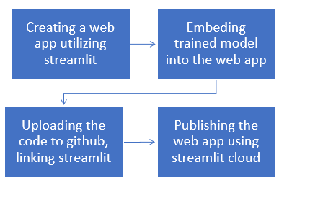
Deployment
For this project, the trained is deployed for inference using an interactive web app. Interactive web app is created streamlit.
The web application contains three pages introduction, prediction and visualization. Prediction pages provides inference services for user defined features variables. Dynamic visualization offers valuable insights about various factors affecting the restaurant establishment at different locations.
After creating the streamlit app and testing it on local machine, code is pushed to github and linked to streamlit cloud. Specifying the branch to be utilized for creating web app, we will in creating an app hosted on streamlit cloud.

